Slide 1
Keep it simple saints
Personal Ministries Leadership Symposium
J. Alfred Johnson II, NAD Director of Adult Ministries
Facilitator

Slide 2
“Keep It Simple Saints”
Personal Ministries Is:
“Any Ministry Carried out
By Individual Members or Small Groups
Which Is Focused On
Direct Evangelistic Contact”

Slide 3
“Keep it simple saints”
Personal Ministries Participants Are:
Members Who Ask The Holy Ghost To Assist Them In The Process Of Doing What God Has Called Them To Do!

Slide 4
introduction
Four Things About
Personal Ministries Leadership
I Wish Someone Had Shared With Me

Slide 5
Four Things About PM Leadership I Wish Someone Had shared with Me:
“It’s Not about you”
The Baptism Of The Holy Ghost IN and On Us
Start with Simple Options
Multiply Resources

Slide 6
I “It’s Not About You” – It’s ALL about Humble Servant-Leadership
A. C.T. Richards said, “Attitude
Determines Altitude”
Micah 6:8
1. If you feel or act exalted
because of your “Position”,
it is time for you to change,
or to move away from the
“Position”.

Slide 7
I “It’s Not About You” – It’s ALL about Humble Servant-Leadership
B. “Do everything you can to end the “War”
between The Sabbath School and Personal
Ministries Departments!
1. When a problem exists, the source is either negative “Ego”, or “Lack” of understanding of the Mission of each Ministry.

Slide 8
THE MISSION OF “BOTH” SABBATH SCHOOL AND PERSONAL MINISTRIES
Bible Study – Which Propels Action!
Community Outreach – Gets The Job Done!
Fellowship and Nurture – Provides The “Warm” Support Atmosphere
World Mission – “Prepares For The Coming!”

Slide 9
WHAT “IF” -
An Assistant
Sabbath School Superintendent served as
ASSISTANT
PERSONAL MINISTRIES LEADER FOR OUTREACH?!

Slide 10
II “The Baptism Of The Holy Ghost IN and On Us Makes ALL Ministries Go!”
A. Galatians 5:22, 23 –The Holy Ghost “IN” Us
The Fruit Of The Spirit = “Be Power”!
B. Acts 1:8 – The Holy Ghost “ON/UPON Us”
Us = “Do Power”!
When empowered from “On High”, we
CANNOT – NOT thrive!

Slide 11
III “Start With Simple Options That Anyone Can “Plug-In” To
For example:
A. The Kindness Initiative, by W.C. Scales, Jr. – 100 For One! (Also see festivalofthelaity.com)
“If we would humble ourselves before God. And be kind and courteous, tenderhearted and pitiful (compassionate). There would be one hundred conversions to the Truth, where now there is only one.” 9T 189

Slide 12
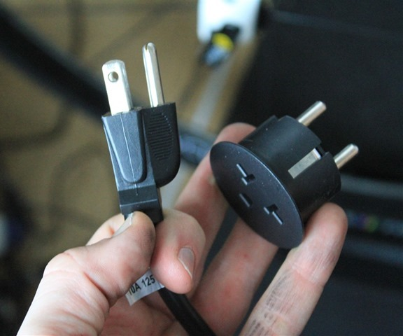
III “Start With Simple Options That Anyone Can “Plug-In” To
For example:
Have Local Church “Days Of Hope and Compassion”
www.compassionmovement.org
1. Days on which ALL
MEMBERS “Go Out” to
Model the
Compassion/Kindness of
Christ!

Slide 13
IV MULTIPLY Resources - all of which add Value To Your Ministry Arsenal
A. All resources on www.festivalofthelaity.com
B. Personal Ministries Quick Start Guide on
www.festivalofthelaity.com (Personal Ministries
section) or at www.adventsource.org
C. www.sabbathschoolpersonalministries.com

Slide 14
IV MULTIPLY Resources - all of which add Value TO Your Ministry Arsenal:
C. International Institute of Christian Ministries (IICM)
D. Google Personal Ministries Cool Tools
E. Sabbath School Tool Box Magazine (available through Pacific Press) and soon on FOL.Com

Slide 15
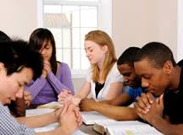
V In Conclusion
A. May our Lord’s anointing “IN” and “UPON/ON” drive you to “Keep your participation simple” and powerful!
May OUR PRAYER
ALWAYS BE

Slide 16
Make Me A Magnet
Make me a magnet in Thy hand, to draw some souls to Thee;
Give me The Spirit’s power to show the love of Calvary.
Awaken in my soul a zeal to save my fellow men –
Sanctify and bless and use my hands, my lips, my pen.
Make me a magnet in Thy hand, I can do nothing alone;
May all my Prayers of others’ needs ascend unto Thy throne.
May all I do be wrought in thee, may self be crucified,
And souls accept their blessed Lord, who on Golgotha died.
Make me a magnet, Lord, to draw hearts hard and cold as steel;
Help me to show Thy glorious self – Thy tender love reveal.
And when the storms of life are over, the earthly tasks are done,
May I rejoice in seeing souls whom I for Thee have won.
- Margaret Locke

Slide 17
MAY THE POWER
OF GOD’S ANOINTING
BE “IN” AND “UPON” YOU
AND – AND ALL WITH WHOM YOU SERVE!

Slide 18
NAD Adult Ministries Department
J. Alfred Johnson II, Director jalfredjohnson@nadadultministries.org
O: 301.680.6431; C: 301.367.7818
Anika Anderson, Administrative Assistant anikaanderson@nadadventist.org
301.680.6430
Dr. Cleveland Houser, Prison Ministry Coordinator
cleve.houser@yahoo.com

